Slide 1
Gesture Keyboard Controller
An AI-Powered Real-Time Gesture Recognition System
Presented by: Sehajveer Singh & Udai Batta

Slide 2
Abstract
This project implements a fast, low-cost, and accurate hand gesture recognition system to emulate arrow key inputs in real-time. Using just a webcam and Python, it uses MediaPipe and OpenCV for gesture interpretation, while ctypes triggers system-level key presses. The system is ideal for gaming, accessibility, and touchless interfaces.

Slide 3
Project Objectives
✔ Achieve over 95% gesture recognition accuracy
✔ Enable real-time directional key control
✔ Ensure latency below 150ms
✔ Provide seamless compatibility with games, slideshows, browsers
✔ Minimize hardware dependencies — only a webcam required

Slide 4
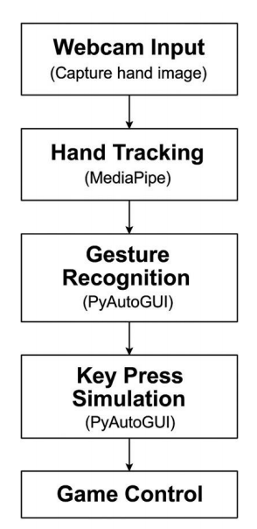
System Architecture
📸 Webcam Input → 🤖 MediaPipe Hand Detection → 🧠 Gesture Logic → ⌨️ Key Simulation
Each frame is processed to detect hand landmarks, translated into binary finger states and mapped to keys using ctypes for OS-level simulation.

Slide 5
Tech Stack & Tools
🧪 Python 3.x
🧠 MediaPipe – Hand tracking
🎥 OpenCV – Frame processing + UI overlay
🧰 ctypes – Native Windows key simulation
💻 Standard laptop webcam (no extra hardware)

Slide 6
Results & Performance
📈 Frame Rate: 18–25 FPS (average)
⚡ Latency: <150ms
🎯 Gesture Accuracy: >95%
🧠 Cooldown logic reduces false positives
🎮 Works on games, media players, browsers, etc.

Slide 7
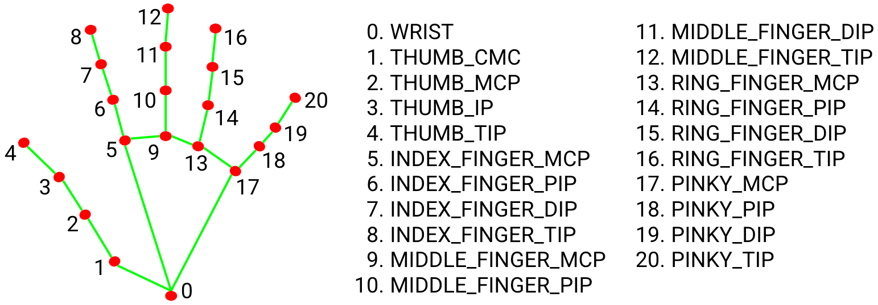
Sample Detected Gesture (Right)

Slide 8
🌍 Real-World Use Cases
💡 Accessibility Tools:
Control interfaces without physical input — ideal for users with limited mobility.
🎮 Gaming & Media:
Hands-free control in racing, maze, or rhythm games — adds an immersive experience.
🧼 Sterile Environments:
Hospitals or clean rooms where touchless control is essential.
📽️ Presentation Control:
Use gestures to switch slides or interact in workshops and classrooms without needing a clicker.

Slide 9
Conclusion & Future Scope
✅ A gesture-based interface was built using Python + webcam
✅ Achieved real-time response with no special hardware
🔮 Future Ideas:
• Dynamic gestures like swipes
• Multi-hand support
• Integration with voice/gaze tracking

